Slide 1
Machine Learning

Slide 2
Topics
Introduction to Machine Learning
Machine Learning Use Cases
Machine Learning Project Life-Cycle
Machine Learning Types
Machine Learning Problems
Machine Learning Algorithms
Naïve bayes
KNN
Decision Tree
Random Forest
Linear Regression
Logistic Regression
Support Vector Machine
K-means Clustering
Models Evaluation

Slide 3
Introduction to a Machine Learning
Machine learning is a subfield of artificial intelligence
Field of study that gives computers the capability to learn without being explicitly programmed
Can defined as the capability of a machine to imitate intelligent human behavior
It is the study of making machines more human-like in their behavior and decisions by giving them the ability to learn and develop their own programs
The learning process is automated and improved based on the experiences of the machines throughout the process
Machine learning starts with data : Texts, numbers, photos
Data can be from different resources : bank transactions, pictures of people, repair records, time series data from sensors, or sales reports
Data is gathered and prepared to be used as training data into a machine learning algorithm

Slide 4
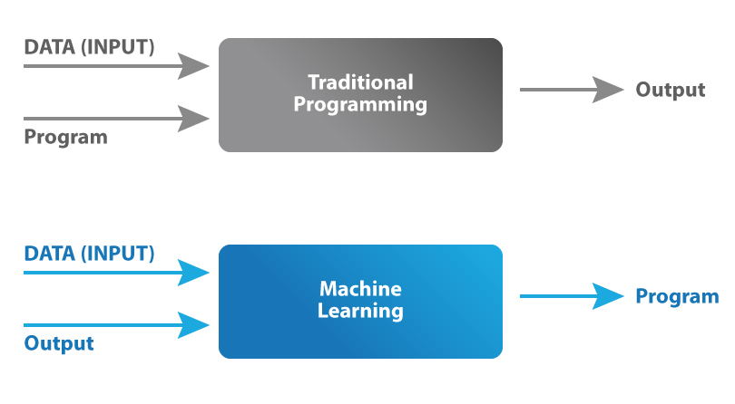
Introduction to a Machine Learning
Good quality data is fed to the machines, and different algorithms are used to build ML models to train the machines on this data.
The choice of algorithm depends on the type of data at hand, and the type of activity that needs to be automated.
What is the difference between Machine Learning and Traditional Programming
In traditional programming, we would feed the input data and a well written and tested program into a machine to generate output
machine learning, input data along with the output is fed into the machine during the learning phase, and it works out a program for itself

Slide 5
Introduction to a Machine Learning
Why should we learn Machine Learning?
It can automate many tasks, especially the ones that only humans can perform with their innate intelligence
Replicating this intelligence to machines can be achieved only with the help of machine learning
Machine Learning VS Deep Learning
Factor | Machine Learning | Deep Learning
Data Requirement | Little data is required | It needs a lot of data
Data Example | Numeric | Numeric, Images, Texts, Audios, Videos,…etc.
Accuracy | Lesser accuracy | Higher accuracy
Training Time | Less time to train | Long time to train
Hardware needed | Train on CPU | Requires GPU

Slide 6
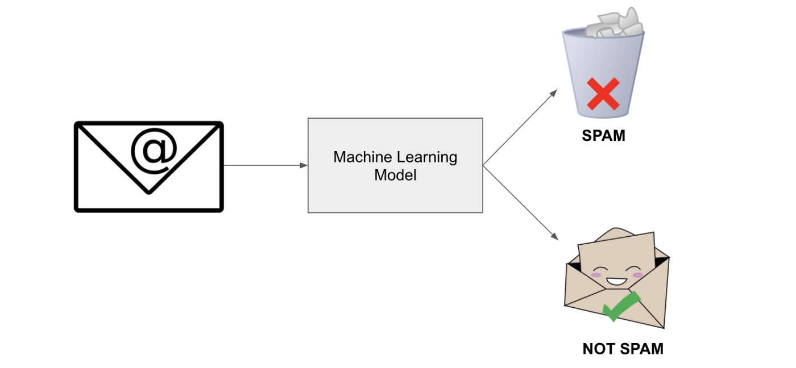
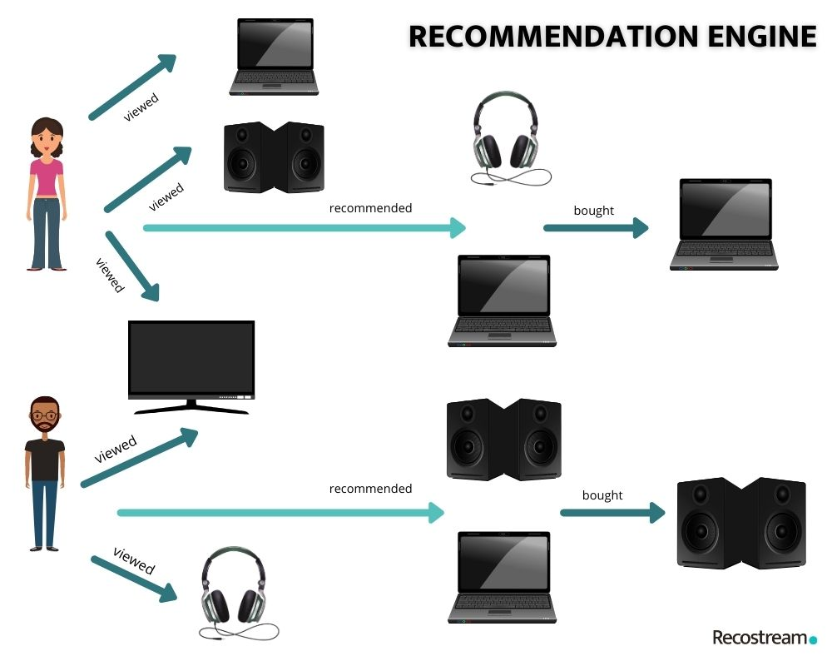
Machine Learning Use Cases - 1
Machine Learning Projects
Identifying Spam
Most of your email inboxes also have an bulk, or spam inbox
Where email provider automatically filters unwanted spam emails
Machine Learning model train to identify all the spam emails based on common characteristics such as the email, subject, and sender content
Recommender systems
These systems are used everywhere by: search engines, e-commerce websites (Amazon), entertainment platforms (Google Play, Netflix), and multiple web & mobile apps
These recommendations are typically based on behavioral data and parameters such as previous purchases, item views, page views, clicks, form fill-ins, purchases, item details (price, category), and contextual data (location, device), and browsing history

Slide 7
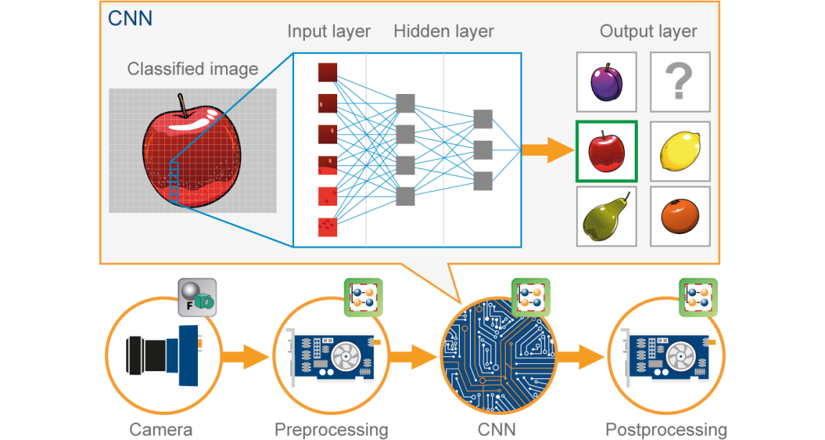
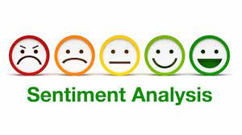
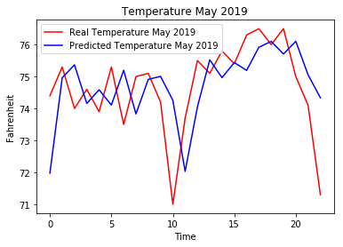
Machine Learning Use Cases - 2
Image & Video Recognition
Image & video recognition techniques are used for multiple areas, including object detection, face recognition, text detection, visual search, logo and landmark detection
Using Deep Learning where algorithms are more complex than Machine Learning
Manipulating with Images or videos need to use Computer Vision techniques to process data and extract features from images then using Deep Learning to make detection, recognition, or classification
Sentiment Analysis
One of the beneficial machine learning applications
Help to determine the emotion or opinion of the speaker or the writer.
analyze the sentiments behind the texts e.g. : Analyze feedback for the hotel or restaurant
Weather Forecasting
Machine Learning can be used to forecast weather with historical weather data
Based on observations of the weather in the past we can predict the weather in the future
Data collected from weather stations and satellites

Slide 8
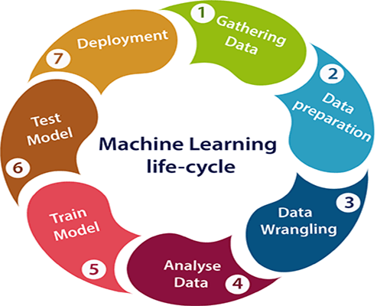
Machine Learning Project Life-Cycle - 1
Gathering Data
Data Gathering is the first step of the machine learning life cycle
The goal of this step is to identify and obtain all data-related problems
We need to identify the different data sources such as files, database, ..etc.
This step includes the below tasks:
Identify various data sources
Collect data
Integrating data from different sources
Data exploration
Used to understand the nature of data that we have to work with
Understand the characteristics, format, and quality of data
A better understanding of data leads to an effective outcome
Data pre-processing
Is the process of cleaning and converting raw data into a useable format
Involve cleaning the data, selecting the variable to use, and transforming the data in a proper format to make it more suitable for analysis
Collected data may have various issues, including: Missing Values, Duplicate data, Invalid data, Noise

Slide 9

Machine Learning Project Life-Cycle - 2
Build a machine learning model
Determination of the type of the problems
Select the machine learning techniques
Training the model
Split data into Training, Validation, and Testing datasets
Fit data into a Machine Learning model
Evaluation the model
Based on the problem using suitable evaluation method for testing the model
Test your model on a new data
Compare between ML results and actual results
Deploy the model
Last step of machine learning life cycle
If the above-prepared model is producing an accurate result as per our requirement with acceptable speed, then we deploy the model in the real system
We will check whether it is improving its performance using available data or not
The deployment phase is similar to making the final report for a project

Slide 10
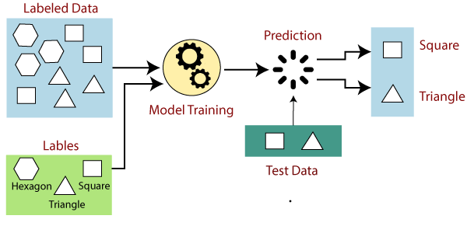
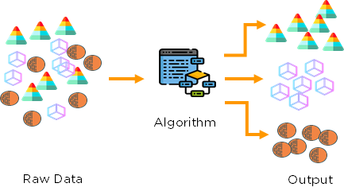
Types of Machine Learning
Machine Learning is divided into mainly four types:
Supervised
Train the machines using the labelled dataset
Labelled data specifies the inputs are already mapped to the output
Train the machine with the input and corresponding output
Ask the machine to predict the output using the test dataset
Unsupervised
The machine is trained using the unlabeled dataset
The model acts on that data without any supervision
The main goal is to group or categories the unsorted dataset according to the similarities, patterns, and differences
Machines are instructed to find the hidden patterns from the input dataset
Reinforcement Learning
Works on a feedback-based process
Agents learn from their experiences only
Is like a human being
For example, a child learns various things by experiences in his day-to-day life
Notes:
Supervised Machine Learning
Suppose we have an input dataset of cats and dog images
1- we will provide the training to the machine to understand the images such as :
Shape & size of the tail of cat and dog
Shape of eyes
Color
Height (dogs are taller, cats are smaller), etc.
2- Start training by understanding the image and mapping it into specific label
3- When we input the picture of a cat and ask the machine to identify the object and predict the output
4- Now, the machine is well trained, so it will check all the features of the object, such as height, shape, color, eyes, ears, tail, etc., and find that it's a cat

Slide 11
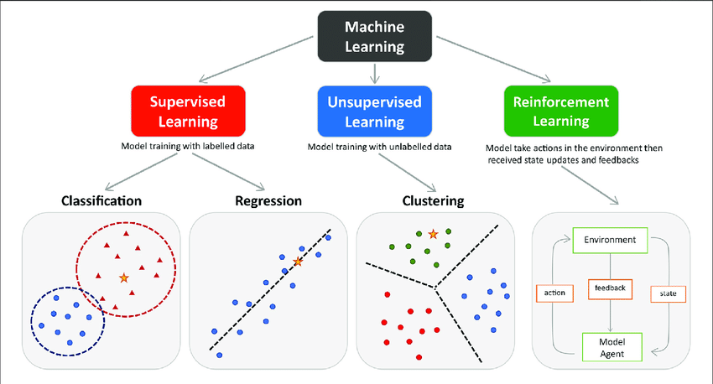
Machine Learning Problems
Supervised Problems :
Classification
Regression
Unsupervised Problems:
Clustering
Association

Slide 12


ML – Classification
The Classification algorithm is a Supervised Learning technique that is used to identify the category of new observations based on training data.
In machine learning, classification refers to a predictive modeling problem where a class label is predicted for a given example of input data
Input data maybe called Samples, Observations, Rows, Features, Independent Variables
Output maybe called Class Label, Dependent Variable
Classification model will use the training dataset and will calculate how to best map examples of input data to specific class labels
Classification types :
Binary Classification
refers to classification tasks that have two class labels
e.g. : Spam email
Multi-Class Classification
refers to classification tasks that have more than two class labels
e.g. : Sentiment Analysis

Slide 13
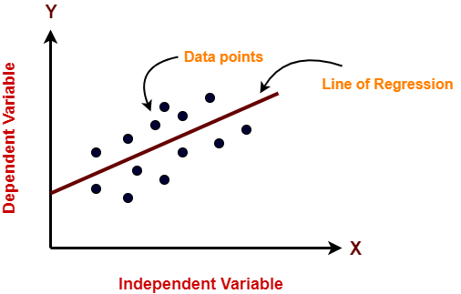
ML – Regression
Regression is a technique for investigating the relationship between independent variables or features and a dependent variable or outcome
Refers to predictive modelling in machine learning
Algorithm is used to predict continuous outcomes
Outcomes can then be predicted once the relationship between independent and dependent variables has been estimated
It is mainly used for prediction, forecasting, time series modeling

Slide 14
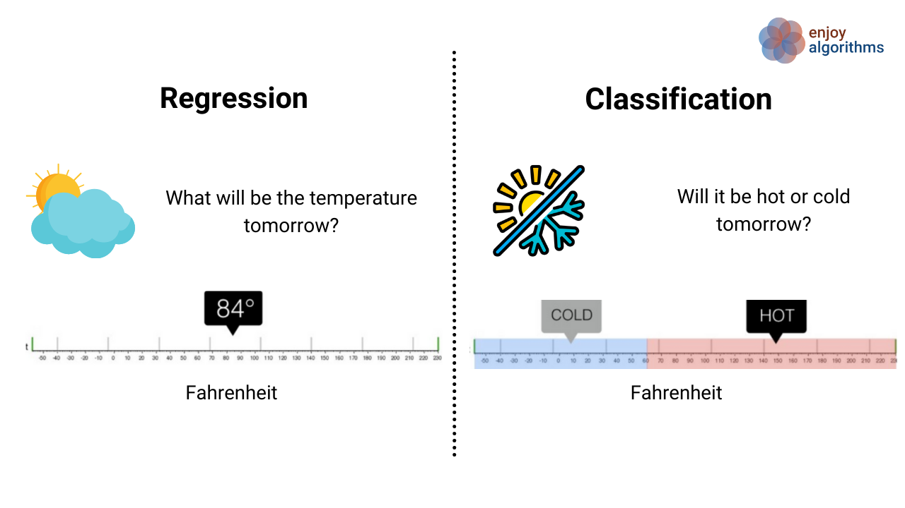
ML – Classification VS Regression

Slide 15
ML – KNN 1
KNN stands for K-Nearest Neighbor
The algorithm can be used to solve both classification and regression problem
The number of nearest neighbors to a new unknown variable that must be predicted or classified is denoted by the symbol K
Its aim is to locate all the closest neighbors around a new unknown data point in order to figure out what class it belongs to
It’s often referred to as a distance-based algorithm
How do we select the right value of K?
There is no method for determining the correct value of K
we’ll try to test the model’s accuracy for different K values
The value of K that delivers the best accuracy for both training and testing data is selected
Task: Why is KNN called a “Lazy Learner”?

Slide 16
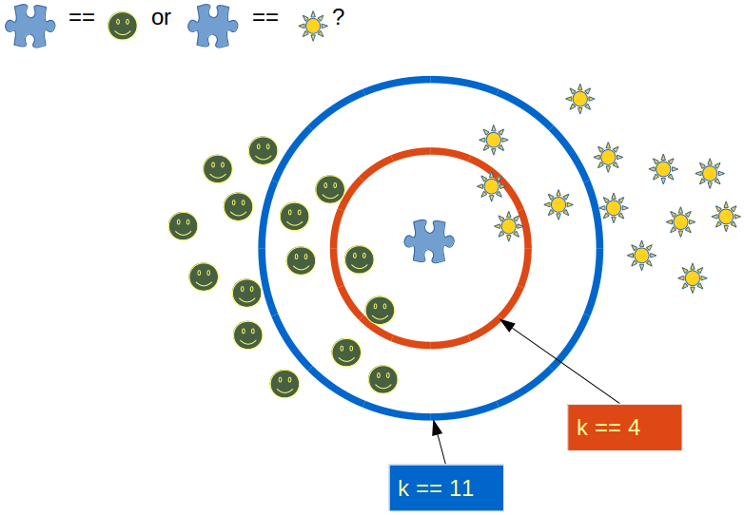
ML – KNN 2
It is recommended to always select an odd value of K
When the value of K is set to even, a situation may arise in which the elements from both groups are equal
Choosing an odd value for K is preferred because such a state of equality between the two classes would never occur here

Slide 17
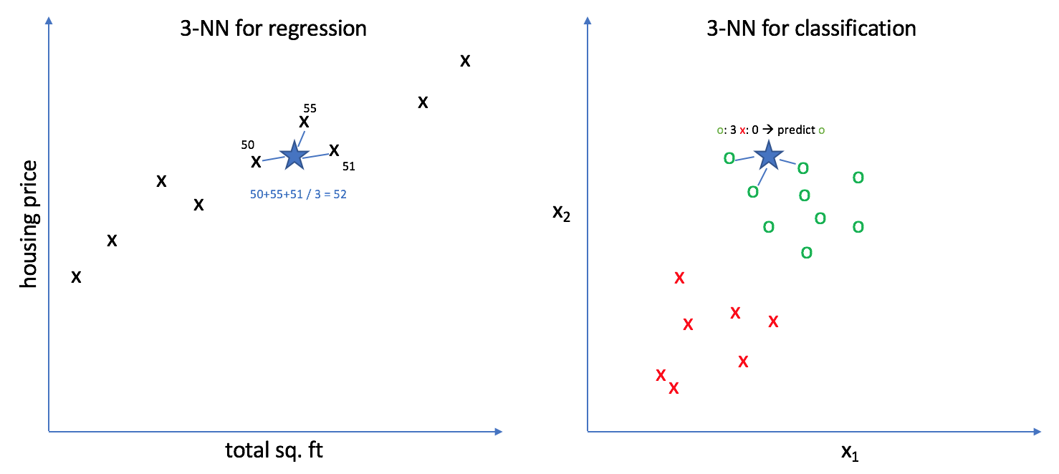
ML – KNN in Classification and Regression
Classification problem
KNN tends to use the concept of “Majority Voting”
Where the class with the most votes is chosen
Regression
KNN employs an average method for predicting the value of new data
Based on the value of K, it would consider all the nearest neighbors

Slide 18
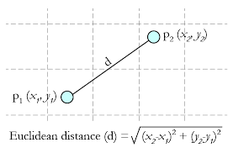
ML – KNN How to Calculate Distance?
For calculating distances KNN uses a distance metric from the list of available metrics
Minkowski Distance
Manhattan Distance
Euclidean Distance (most widely used)
Cosine Distance
Euclidean Distance

Slide 19
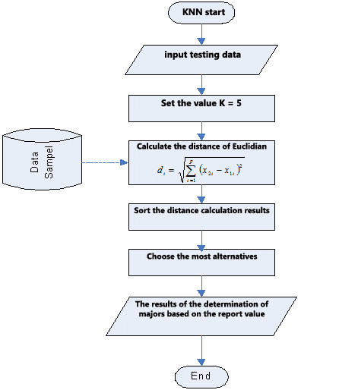
ML – KNN Algorithm Steps
Step-1: Select the number K of the neighbors
Step-2: Calculate the Euclidean distance of K number of neighbors
Step-3: Take the K nearest neighbors as per the calculated Euclidean distance.
Step-4: Among these k neighbors, Apply majority voting method (Classification). Apply average method (Regression)
Step-5: Assign the new data points to that category (Classification) for which the number of the neighbor is maximum. (Regression) for the mean value for K neighbors

Slide 20
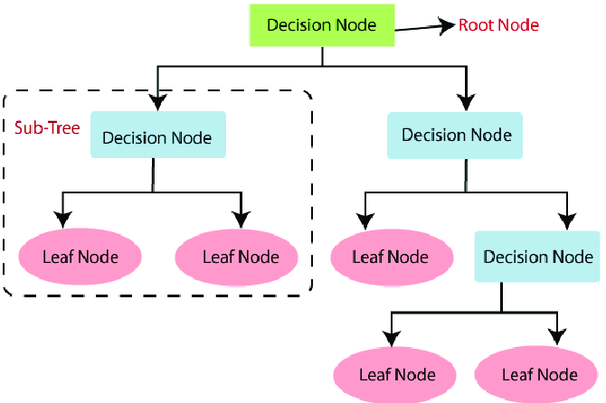
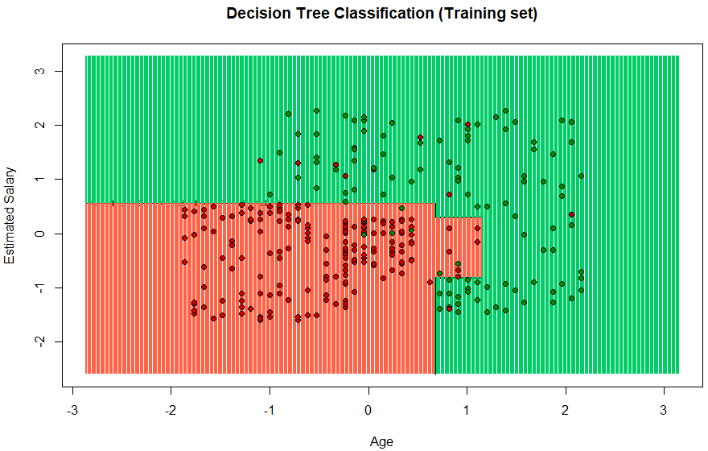
ML – Decision Tree 1
Decision Tree is a Supervised learning technique that can be used for both Classification and Regression problems
It is preferred for solving Classification problems
There are two types of nodes in decision tree:
Decision Node : are used to make any decision and have multiple branches
Leaf Node : are the output of those decisions and do not contain any further branches
It is a graphical representation for getting all the possible solutions to a problem/decision based on given conditions
A decision tree can contain categorical data (YES/NO) as well as numeric data
Notes:
Root Node: Root node is from where the decision tree starts. It represents the entire dataset, which further gets divided into two or more homogeneous sets.
Leaf Node: Leaf nodes are the final output node, and the tree cannot be segregated further after getting a leaf node.
Splitting: Splitting is the process of dividing the decision node/root node into sub-nodes according to the given conditions.
Branch/Sub Tree: A tree formed by splitting the tree.
Pruning: Pruning is the process of removing the unwanted branches from the tree.
Parent/Child node: The root node of the tree is called the parent node, and other nodes are called the child nodes.

Slide 21
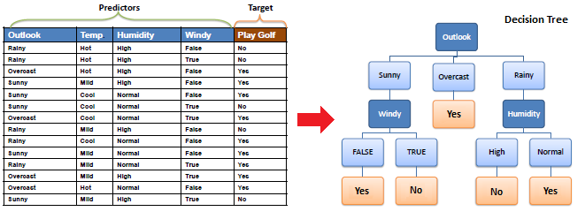
ML – Decision Tree 2
Example A decision node (e.g., Outlook) has two or more branches (e.g., Sunny, Overcast and Rainy). Leaf node (e.g., Play) represents a classification or decision.
For more details :
https://www.saedsayad.com/decision_tree.htm

Slide 22
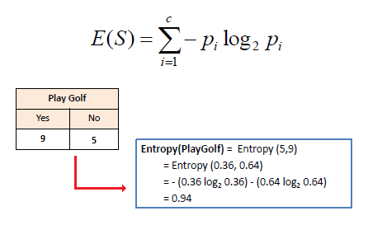
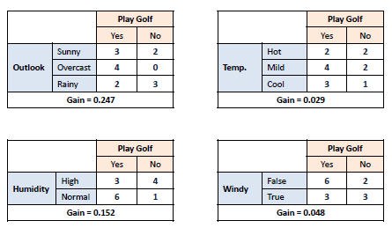
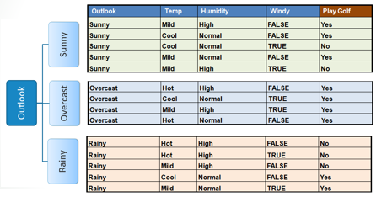
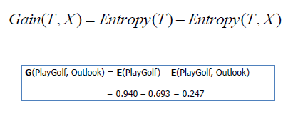
ML – Decision Tree 3
How to build a Decision Tree?
Step-1: Calculate Entropy for one attribute (Target/Label)
Step-2: For each attribute in the dataset calculate the Entropy for two attributes (feature and target)
Step-3: Calculate Information Gain
Step-4: Choose attribute with largest Information Gain to a decision node
Step-5: Split data based on values in decision node
Step-6: Repeat the steps until reach to leaf nodes
1-Entropy for one attribute
2-Calculate Information Gain for all attributes
5-split data

Slide 23
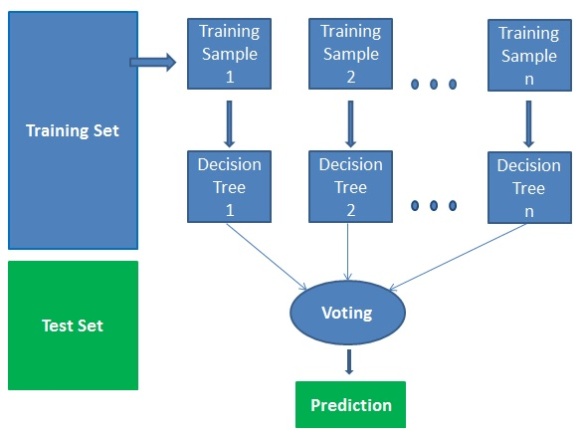
ML – Random Forest 1
Random Forest is a popular supervised machine learning technique
Random Forest is a classifier that contains number of decision trees on various subsets of the given dataset, then takes the average to improve the predictive accuracy of that dataset
It is based on the concept of ensemble learning
Ensemble learning is a process of combining multiple classifiers to solve a complex problem and to improve the performance of the model
Random Forest takes the prediction from each tree and based on the Majority Votes of predictions, and it predicts the final output

Slide 24
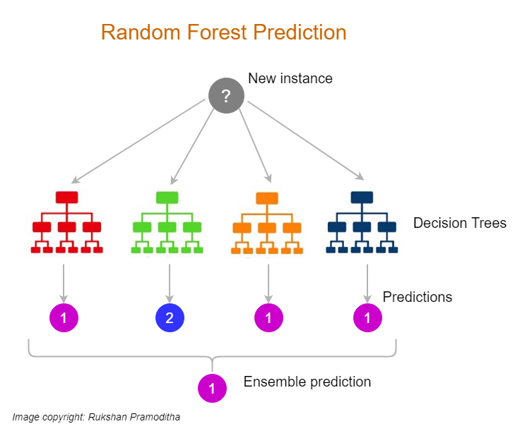
ML – Random Forest 2
Why use Random Forest?
Takes less training time as compared to other algorithms.
Predicts output with high accuracy, even for the large dataset it runs efficiently
Maintain accuracy when a large proportion of data is missing
How does Random Forest algorithm work?
Step-1: Select random K data points from the training set
Step-2: Build the decision trees associated with the selected data points (Subsets)
Step-3: Choose the number N for decision trees that you want to build
Step-4: Repeat Step 1 & 2
Step-5: Find the predictions of each decision tree
Step-6: Assign the new data points to the category that wins the majority votes

Slide 25
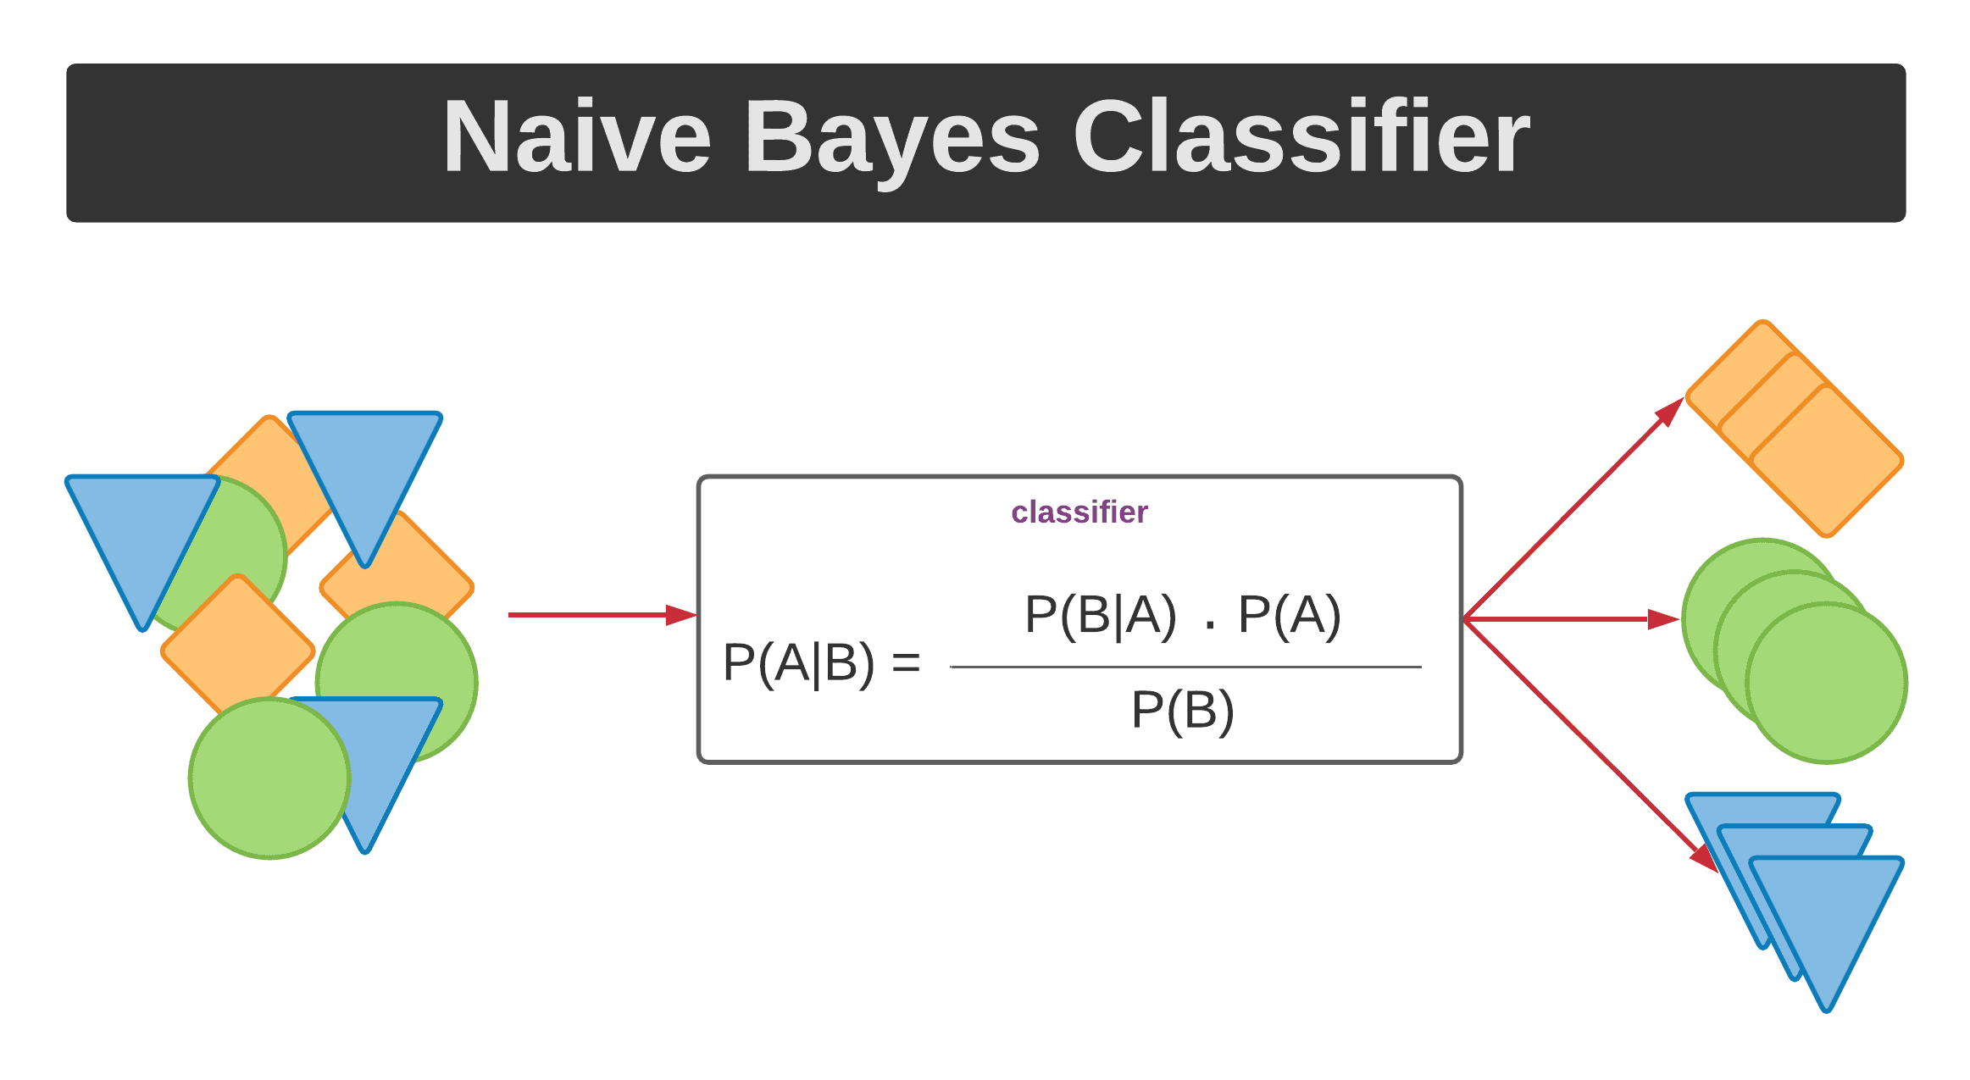
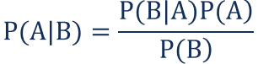
ML – Naïve Bayes 1
Naïve Bayes is a statistical classification ML algorithm, based on Bayes theorem
Used for solving Classification problems.
Naïve Bayes Classifier consider as a simple and effective Classification algorithms
It is a probabilistic classifier, which means it predicts based on the probability of an object
We can say “Naïve” because it assumes that the occurrence of a certain feature is independent of the occurrence of other features.
What is a Bayes Theorem? - It’s a rule that used to determine the probability of hypothesis with prior knowledge - It depends in conditional probability
The formula for Bayes' theorem is given as:
P(A|B) – the probability of event A occurring, given event B has occurred
P(B|A) – the probability of event B occurring, given event A has occurred
P(A) – the probability of event A
P(B) – the probability of event B

Slide 26
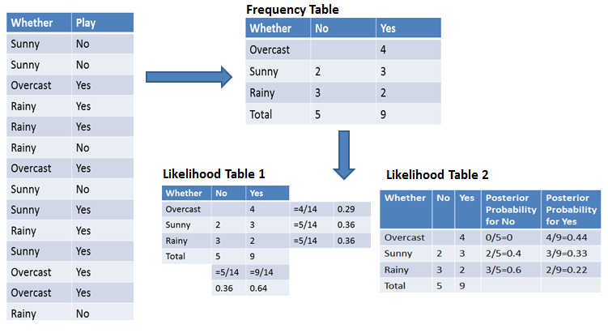
ML – Naïve Bayes 2
How Naive Bayes Classifier Works?
Example we'll classify whether players will play or not, based on the weather condition
First Approach (In case of a single feature)
Step 1: Calculate the prior probability for given class labels
Step 2: Find Likelihood probability with each attribute for each class
Step 3: Put these value in Bayes Formula and calculate posterior probability.
Step 4: See which class has a higher probability, given the input belongs to the higher probability class.
Probability of playing:
P(Yes | Overcast) = P(Overcast | Yes) P(Yes) / P (Overcast)
P(Overcast) = 4/14 = 0.29
P(Yes)= 9/14 = 0.64
P (Yes | Overcast) = 0.44 * 0.64 / 0.29 = 0.98
Probability of not playing:
P(No | Overcast) = P(Overcast | No) P(No) / P (Overcast)
P(Overcast) = 4/14 = 0.29
P(No)= 5/14 = 0.36
P (No | Overcast) = 0 * 0.36 / 0.29 = 0

Slide 27
ML – Naïve Bayes 3
Second Approach (In case of multiple features)
suppose you want to calculate the probability of playing when the weather is overcast, and the temperature is mild.
Probability of playing:
1--- > P(Play= Yes | Weather=Overcast, Temp=Mild) = P(Weather=Overcast, Temp=Mild | Play= Yes)P(Play=Yes)
2--- > P(Weather=Overcast, Temp=Mild | Play= Yes)= P(Overcast |Yes) P(Mild |Yes)
Calculate Prior Probabilities: P(Yes)= 9/14 = 0.64
Calculate Posterior Probabilities: P(Overcast |Yes) = 4/9 = 0.44 , P(Mild |Yes) = 4/9 = 0.44
Put Posterior probabilities in equation (2) P(Weather=Overcast, Temp=Mild | Play= Yes) = 0.44 * 0.44 = 0.1936(Higher)
P(Play= Yes | Weather=Overcast, Temp=Mild) =
0.1936*0.64 = 0.124
Yes
Probability of not playing:
3 --- > P(Play= No | Weather=Overcast, Temp=Mild) = P(Weather=Overcast, Temp=Mild | Play= No)P(Play=No)
4 --- > P(Weather=Overcast, Temp=Mild | Play= No)= P(Weather=Overcast |Play=No) P(Temp=Mild | Play=No)
Calculate Prior Probabilities: P(No)= 5/14 = 0.36
Calculate Posterior Probabilities: P(Weather=Overcast |Play=No) = 0/9 = 0 , P(Temp=Mild | Play=No)=2/5=0.4
Put posterior probabilities in equation (4) P(Weather=Overcast, Temp=Mild | Play= No) = 0 * 0.4= 0
No
P(Play= No | Weather=Overcast, Temp=Mild) = 0*0.36=0
Res.
The probability of a 'Yes' class is higher

Slide 28
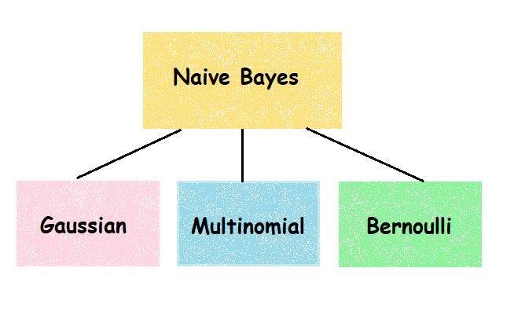
ML – Naïve Bayes 4
There are three types of Naive Bayes Model, which are given below:
Gaussian: The Gaussian model assumes that features follow a normal distribution. This means if predictors take continuous values instead of discrete, then the model assumes that these values are sampled from the Gaussian distribution.
Multinomial: It is primarily used for document classification problems E.g., Classify document belongs to which category *The classifier uses the frequency of words for the predictors.
Bernoulli: The Bernoulli classifier works like the Multinomial classifier, but the predictor variables are the independent Booleans variables. Such as if a particular word is present or not in a document. This model is also famous for document classification tasks.

Slide 29
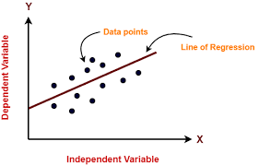
ML – Linear Regression 1
Linear regression is one of most popular machine learning algorithm
Used for regression problems
Linear Regression make prediction for continues values such as price, salary, age, ..etc.
Linear regression algorithm shows a linear relationship between a dependent (y) and one or more independent (x) variables
Linear regression model provides a sloped straight line representing the relationship between the variables
Y = a0 + a1 X
Y= Dependent Variable
X= Independent Variable
a0= intercept of the line
a1 = Linear regression coefficient

Slide 30
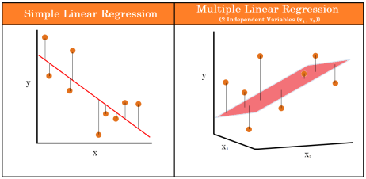
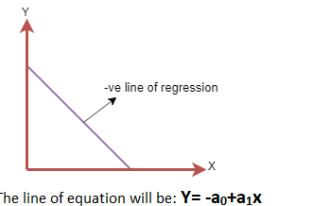
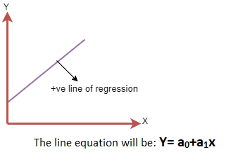
ML – Linear Regression 2
Types of Linear Regression
Simple Linear Regression: single independent variable is used to predict the value of a numerical dependent variable
Multiple Linear regression: more than one independent variable is used to predict the value of a numerical dependent variable
Y = a0 + a1 X
Y = a0 + a1 X1 + a2 X2 + … + an Xn
Regression Line can show two types of relationship
Positive
Negative

Slide 31
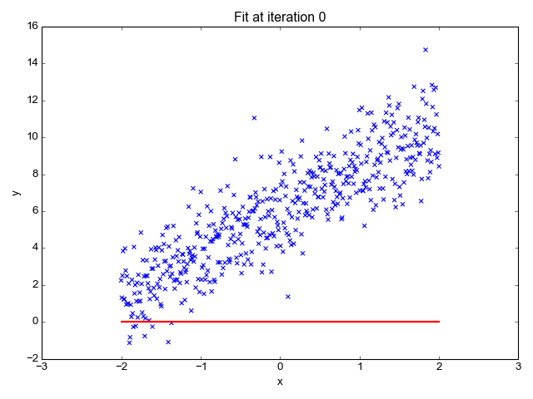
ML – Linear Regression 3
Best Fit Line
The main goal is to find best fit line that represent the minimum error value between actual label value and predicted label
The different values for weights or the coefficient of lines (a0, a1) gives a different line of regression
we need to calculate the best values for a0 and a1 to find the best fit line
We use cost function and gradient descent to calculate the error rate and minimize it

Slide 32
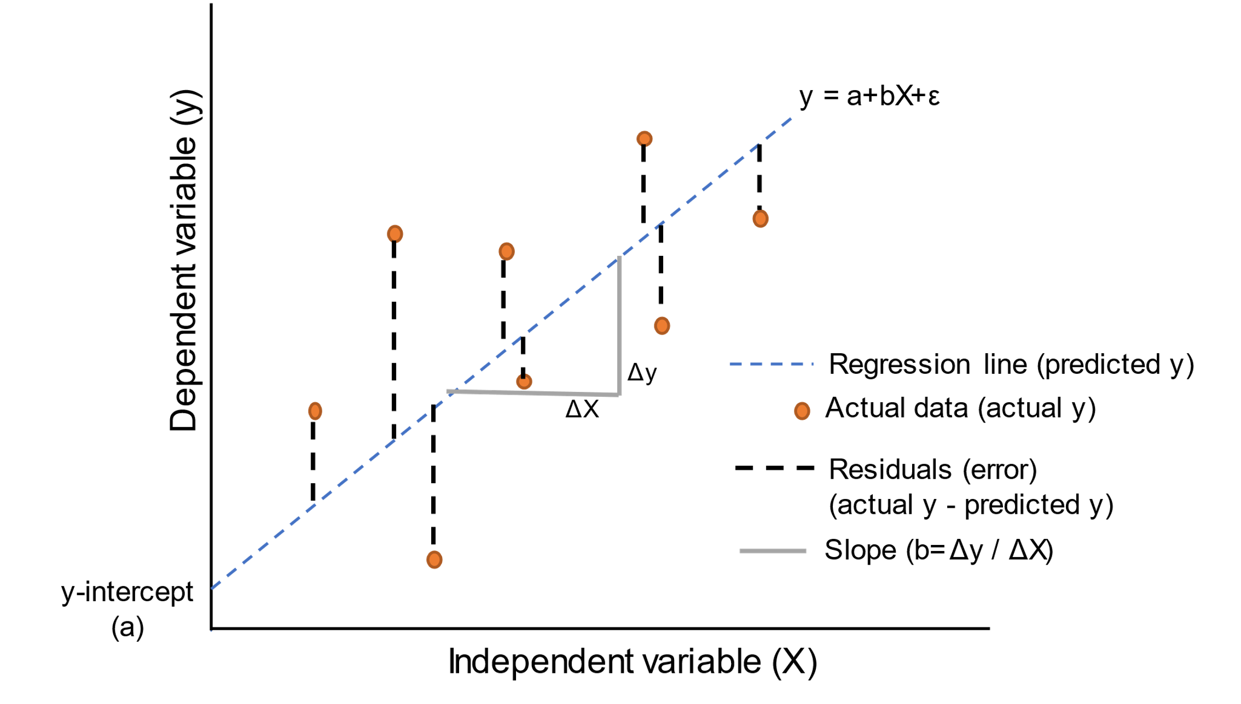
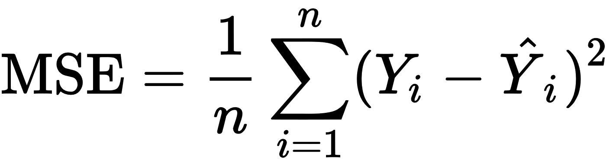
ML – Linear Regression 4
Cost function
Cost function is a measure of how wrong the model is in estimating the relationship between X(input) and Y(output) Parameter
Used to estimate the values of the coefficient for the best fit line
For Linear Regression, we use the Mean Squared Error (MSE) cost function
Residuals: The distance between the actual value and predicted values is called residual
actual value
predicted value
number of data points

Slide 33
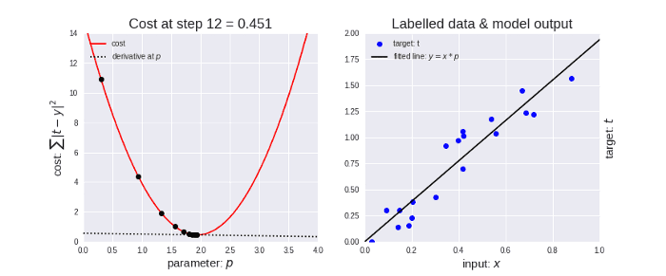
ML – Linear Regression 5
Gradient Descent used to minimize the MSE by calculating the gradient of the cost function
A regression model uses gradient descent to update the coefficients of the line by reducing the cost function.
It is done by :
Random selection of values of coefficient
Iteratively update the values to reach the minimum cost function.

Slide 34

ML – Logistic Regression 1
Logistic regression is a Machine Learning algorithm
Used for classification problems
Used for predicting the categorical values use a given set of independent variables
Instead of giving values as 0 and 1, it gives the probabilistic values which lie between 0 and 1
In Logistic regression, instead of fitting a regression line, we fit an "S" shaped logistic function, which predicts two maximum values (0 or 1).

Slide 35
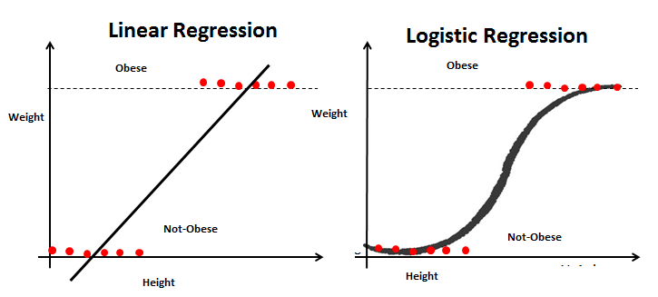
ML – Logistic Regression 2
Steps of Logistic Regression
To calculate the binary separation, first, we determine the best-fitted line by following the Linear Regression steps
The predicted value gets converted into probability by feeding it to the sigmoid function.
After feed, the output ŷ value to the sigmoid function it retunes a probability value between 0 and 1
Finally, the output value of the sigmoid function gets converted into 0 or 1(discreet values) based on the threshold value. We usually set the threshold value as 0.5. In this way, we get the binary classification

Slide 36
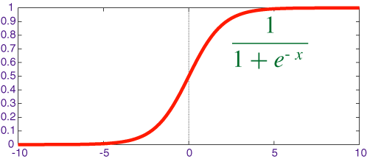
ML – Logistic Regression 3
Logistic Function (Sigmoid Function)
The sigmoid function is a mathematical function used to map the predicted values to probabilities.
It maps any real value into another value within a range of 0 and 1.
The value of the logistic regression must be between 0 and 1
which cannot go beyond this limit, so it forms a curve like the "S" form
The S-form curve is called the Sigmoid function or the logistic function
In logistic regression, we use the concept of the threshold value, which defines the probability of either 0 or 1. Such as values above the threshold value tends to 1, and a value below the threshold values tends to 0.

Slide 37
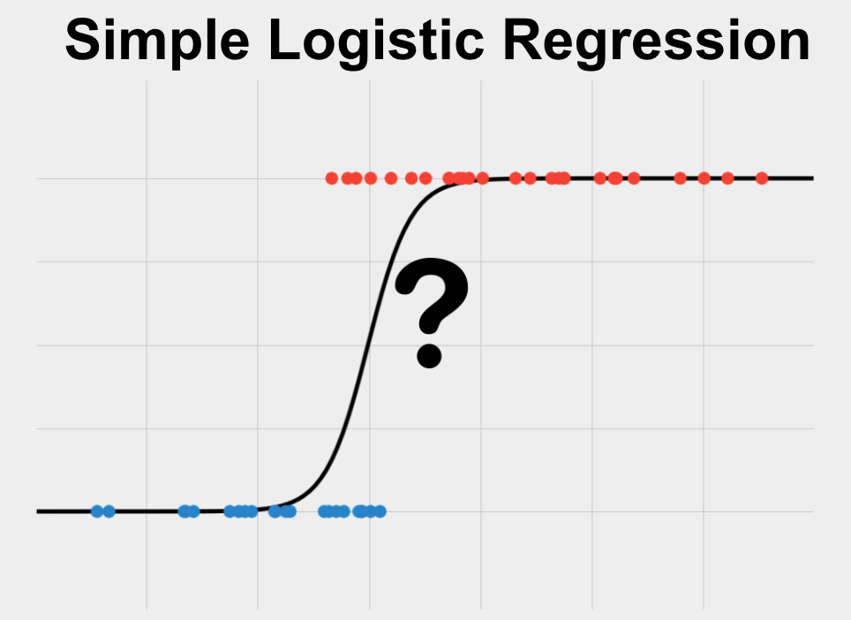
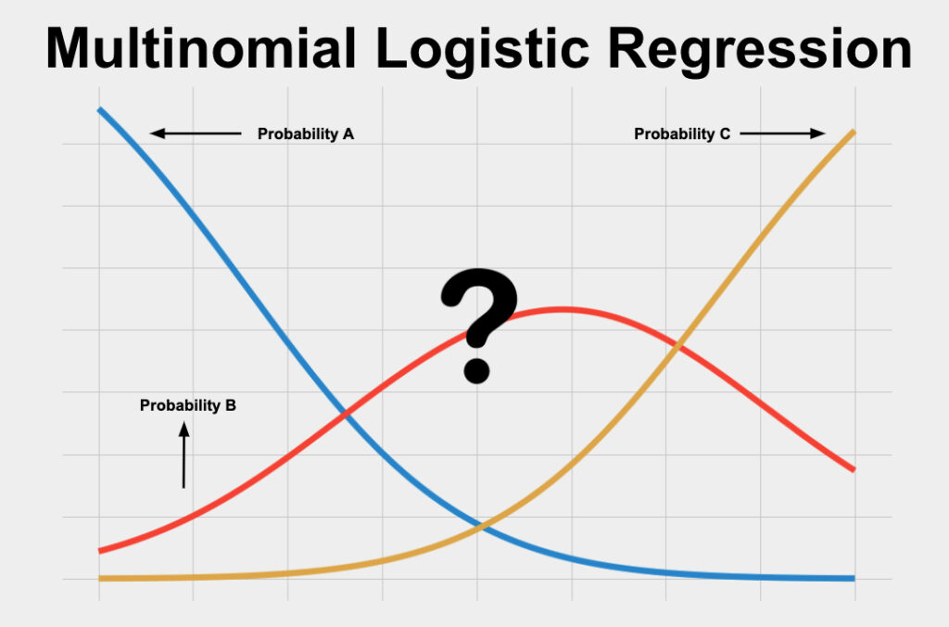
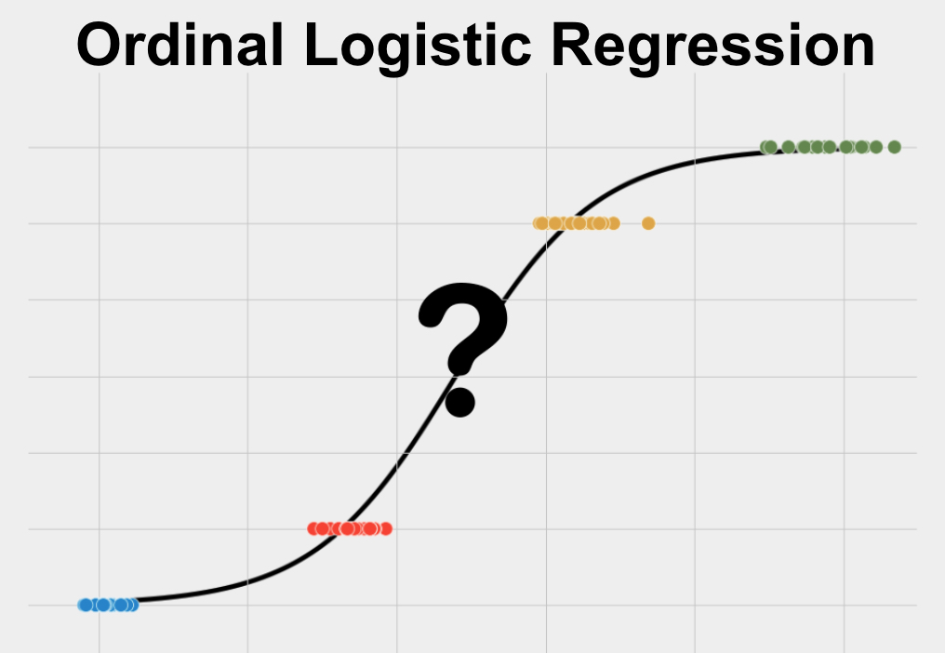
ML – Logistic Regression 4
Based on the categories, Logistic Regression can be classified into three types:
Simple/Binomial: only two possible types of the dependent variables, such as 0 or 1
Multinomial: more than two unordered types of the dependent variable, such as "car", "bus", or "ship"
Ordinal: more than two ordered types of the dependent types variables, such as "low", "Medium", or "High".

Slide 38
ML – Logistic Regression 5
Linear Regression VS Logistic Regression
Similarities :
Both is a Supervised Machine Learning algorithms.
Both the models use linear equations for predictions
Differences :
Difference | Linear Regression | Logistic Regression
Problems | Regression | Classification
output | continuous | discreet
Cost Function | mean squared error | maximum likelihood estimation
The Maximum Likelihood Estimation (MLE) is a method of estimating the parameters of a logistic regression model.

Slide 39
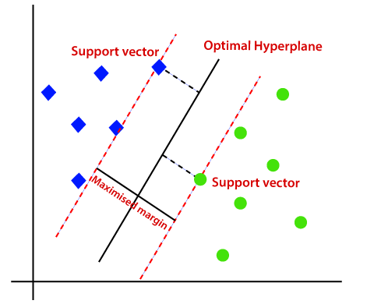
ML – Support Vector Machine SVM 1
Support Vector Machine or SVM is one of the most popular Supervised Learning algorithms
Used for Classification as well as Regression problems
Primarily, it is used for Classification problems
The goal of the SVM algorithm is to create the best line or decision boundary that can segregate n-dimensional space into classes so that we can easily put the new data point in the correct category in the future
This best decision boundary is called a hyperplane
SVM chooses the extreme points/vectors that help in creating the hyperplane.
These extreme cases are called as support vectors, and hence algorithm is termed as Support Vector Machine.

Slide 40
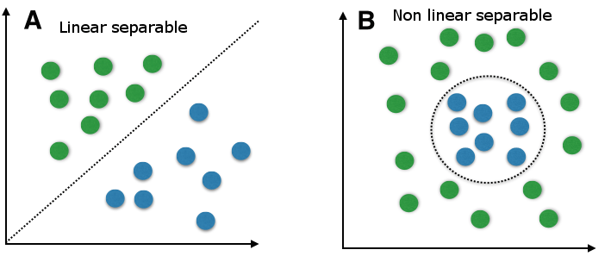
ML – Support Vector Machine SVM 2
Types of SVM
SVM can be of two types: Linear SVM: used for linearly separable data, which means if a dataset can be classified into two classes by using a single straight line Non-linear: used for non-linearly separated data, which means if a dataset cannot be classified by using a straight line, then such data is termed as non-linear data

Slide 41
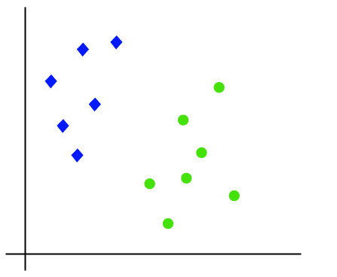
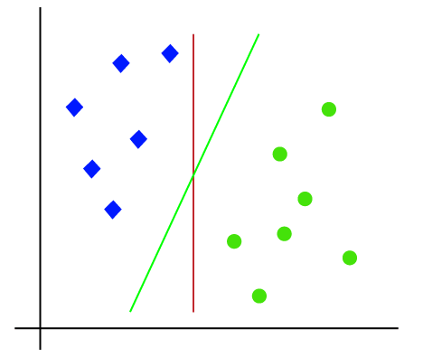
ML – Support Vector Machine SVM 3
How does SVM works?
Linear SVM:
Assume we have a dataset that has two labels (green and blue), and the dataset has two features x1 and x2. We want a classifier that can classify the pair(x1, x2) of coordinates in either green or blue.
We can put multiple lines that can separate these classes
The SVM algorithm helps to find the best line or decision boundary; this best boundary or region is called as a hyperplane
SVM algorithm finds the closest point of the lines from both the classes.
The distance between the vectors and the hyperplane is called as margin.
the goal of SVM is to maximize this margin
The hyperplane with maximum margin is called the optimal hyperplane

Slide 42
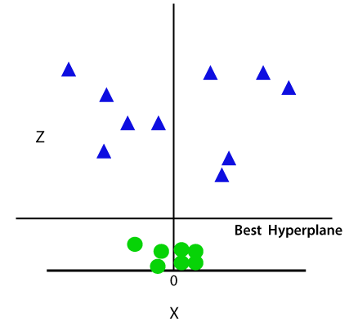
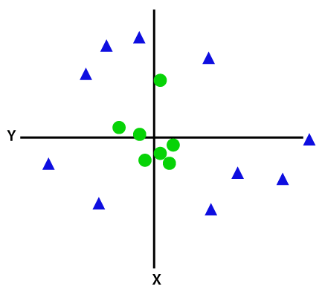
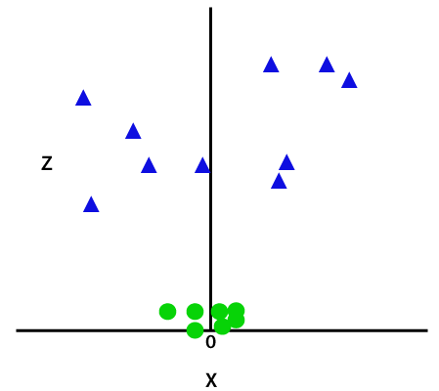
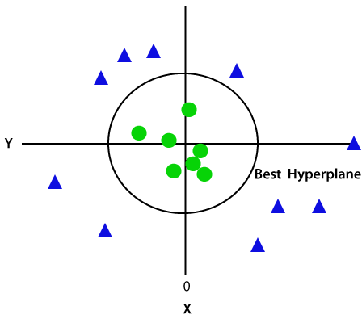

ML – Support Vector Machine SVM 4
Non-Linear SVM:
We cannot draw a single straight line to segregate non-linear data
For linear data, we have used two dimensions x and y
So, for non-linear data, we will add a third-dimension z
It is looking like a plane parallel to the x-axis
z=x^2 +y^2
1
2
Adding the third dimension
SVM will divide the datasets into classes
3
Convert it in 2d space with z=1
We get a circumference of radius 1 in case of non-linear data

Slide 43

ML – Support Vector Machine SVM 5

Slide 44

ML – Evaluate Classification ML Models
The most important task in building any machine learning model is to evaluate its performance
So, how would one measure the success of a machine learning model?
There are different metrics for the tasks of classification and regression
Classification Metrics
Classification is about predicting the class labels given input data
most popular metrics for evaluate classification model :
Confusion Matrix
Accuracy
Precision
Recall
F1-Score

Slide 45

ML – Confusion Matrix
Confusion Matrix in Machine Learning
The confusion matrix is a matrix used to determine the performance of the classification models for a given set of test data.
It can only be determined if the true values for test data are known
For the 2 prediction classes of classifiers, the matrix is of 2*2 table, for 3 classes, it is 3*3 table, and so on
The matrix is divided into two dimensions, that are predicted values and actual values along with the total number of predictions
True Negative: prediction value No, actual value No.
True Positive: prediction value Yes, actual value Yes.
False Negative (Type 2 error): prediction value No, actual value Yes.
False Positive (Type 1 error): prediction value Yes actual value No.

Slide 46


ML – Calculations in Confusion Matrix
F-measure: If two models have low precision and high recall or vice versa, it is difficult to compare these models.
So, for this purpose, we can use F-score
This score helps us to evaluate the recall and precision at the same time.
The F-score is maximum if the recall is equal to the precision
From all our predictions how many of them are correct?
Out of all positive classes that have predicted correctly by the model, how many of them were actually true
It is defined as the out of total positive classes, how our model predicted correctly. The recall must be as high as possible.
From all ground truths, how many are we predicted correctly?
How often the model predicts the correct output

Slide 47



ML – Evaluate Regression ML Models
Metrics to evaluate Regression Model
Two of the most popular metrics for model evaluation in regression:
Mean Square Error(MSE)
Mean Absolute Error(MAE)

Slide 48

ML – K-Means Clustering 1
K-Means Clustering is an unsupervised machine learning algorithm
Used to solve the clustering problems
The main goal is to grouping unlabeled dataset into different clusters
K represent the number of pre-defined clusters that need to be created in the process
It is a centroid-based algorithm
Each cluster is associated with a centroid
The k-means clustering algorithm mainly performs two tasks: 1- Determines the best value for K center points or centroids by an iterative process. 2- Assigns each data point to its closest k-center. Those data points which are near to the k-center, create a cluster.

Slide 49

ML – K-Means Clustering 2
How does the K-Means Algorithm Work?
Step-1: Specify number of clusters K.
Step-2: Initialize centroids by first shuffling the dataset and then randomly selecting K data points for the centroids without replacement
Step-3: Keep iterating until there is no change to the centroids. i.e., assignment of data points to clusters isn’t changing.
Step-4: Compute the sum of the squared distance between data points and all centroids.
Step-5: Assign each data point to the closest cluster (centroid).
Step-6: Compute the centroids for the clusters by taking the average of the all data-points that belong to each cluster

Slide 50

ML – K-Means Clustering 3
How to choose the value of "K number of clusters" in K-means Clustering?
There are some different ways to find the optimal number of clusters
One of the most popular ways to find the optimal number of clusters is Elbow Method
This method uses the concept of WCSS value
WCSS stands for Within Cluster Sum of Squares, which defines the total variations within a cluster

Slide 51

ML – Evaluate Clustering models
In the cluster-predict methodology, we can evaluate how well the models are performing based on different K clusters since clusters are used in the downstream modeling.
There are two metrics that may give us some intuition about k:
Elbow method: It gives us an idea on what a good k number of clusters would be based on the sum of squared distance (SSE) Elbow method gives us an idea on what a good k number of clusters would be based on the sum of squared distance (SSE)
Silhouette analysis: Silhouette analysis can be used to determine the degree of separation between clusters. For each sample: Compute the average distance from all data points in the same cluster . Compute the average distance from all data points in the closest cluster .
We want the coefficients to be as big as possible and close to 1 to have a good clusters.

Slide 52

ML – Deployment ML Models
What Is Machine Learning Model Deployment?
Is the process of placing a finished ML model into a live environment where it can be used for its intended purpose.
Models can be deployed in a wide range of environments, and they are often integrated with apps through an API so they can be accessed by end users
Prepare To Deploy the ML Model
Training ML model
This involves selecting an algorithm, setting its parameters and training it on prepared, cleaned data
Validate the ML Model
Once a model has been trained and its results have been deemed successful, it needs to be validated to ensure that its one-time success was not an anomaly.
Deploy the ML Model
The model needs to be moved into its deployed environment, where it has access to the hardware resources (CPU/GPU, ..etc.) it needs as well as the data source that it can draw its data from.
Second, making it accessible from an end user’s laptop using an API or integrating it into software currently being used by the end user.

Slide 53

ML – API
API - Application Programming Interface
What is an API?
It is the software responsible for the connection for the communication and information exchange between two apps
API connects two devices or programs in order to facilitate the exchange of information between them
It is the interface that serves the other parts of the software
Web APIs
These APIs can be accessed through the HTTP protocol

Slide 54


ML – Python APIs
Python Framework to Build API
Top Frameworks to Build API
1. Django Rest Framework
Django REST is a powerful Django-based framework that the developer uses to create the APIs.
In Django REST, REST stands for Representational State Transfer. It is used for web-based architecture for data communication.
The HTTP request is used to call between machines.
There are four standard methods used in the Django REST framework - GET, PUT, POST, and DELETE.
2. Flask REST Framework
Flask REST framework is the same as the Django REST framework.
It is used to build API quickly.
Flask is known for doing a lightweight project, and it requires a few lines of code to build API.
With the help of this framework, a developer can easily create the API, and many new features are adding to the Flask REST framework.

Slide 55
ML – FLASK
What is Flask?
Flask is a web framework that provides libraries to build lightweight web applications in python
Flask is considered as a micro framework
It is based on WSGI toolkit and jinja2 template engine
What is WSGI?
It’s stand for web server gateway interface which is a standard for python web application development.
It is considered as the specification for the universal interface between the web server and web application
What is Jinja2?
Jinja2 is a web template engine which combines a template with a certain data source to render the dynamic web pages

